Slide 1
Lecture 6
Linked List

Slide 2
Main Points
Main points to know by heart
Pointers
Dynamic Memory Allocation
Linked Lists
Linked List Operators
Doubly Linked List
Exercises

Slide 3
Pointers: a review
Remember: a pointer variable contains not data value, but rather an address of a cell that contains a data value
Direct vs indirect value
Arrays:
Array name is the address of the initial array element
Structures
Structures types are handled by C in exactly the same manner as built in types
Structure variable can be passed by reference
We could represent an array of structures: name is pointer to the first array element

Slide 4
Dynamic Memory Allocation
3 function
malloc, calloc and free
Reside in stdlib.h
malloc
Requires a single argument: a number indicating the amount of memory needed: use sizeof()
calloc
Requires two arguments: the number of array elements needed and the size of an element
Both malloc and calloc return a pointer to the bloc allocated: of type (void*): you should cast to the specific type you need

Slide 5
Accessing a Component of a Dynamically Allocated Structure
You can use the direct component (ex: course.course_name or the indirect component (ex: (*course).course_name or course->course_name)
Either notation can be used to access a component of a dynamically allocated structure: the more concise one is the ->

Slide 6
Linked List

Slide 7
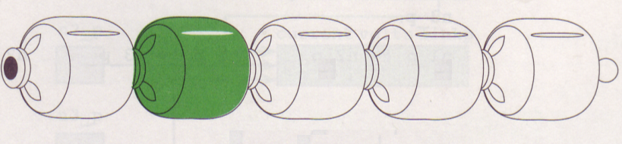

Slide 8
Linked list
A sequence of nodes in which each node is linked, or connected, to the node following it
We can connect or disconnect a node
Assume that we have a chain that consists of three nodes Z, Y and X
We can remove Y by disconnecting the two beads at both its end and then connecting Z and X together
We can add a node M to the chain by connecting it to the bead at either end of the chain, or break the chain it somewhere in the middle and insert M
All nodes will be connected to another node except the last one
Each node will contain the address of the next node except the last one: will contain no address (address will be NULL!!)

Slide 9
Structures with Pointer Components
To construct a dynamic list, we need to use nodes that have pointer components.
As we may not know in advances how many nodes will be in the list (chain), we will allocate storage for each node as needed (malloc or calloc??)
We will use its pointer component to connect it to the next node

Slide 10
Representing a node using a structure
In previous chapters, we used the following structure definition:
typedef struct{
element1;
element2
}structure_name;
In our case, declaring a node, we need a component of a node pointing to another node of the same type!!!!

Slide 11
Solution
Use the following defintion:
typedef struct tag{
element1;
element2;
. .
struct tag *name_ptr;
}YourStructureName;
Example:
Typedef struct node_s{
char current_type[3];
int n_volts;
struct node_s *linkp;
}node_t;
Important: We use struct node_s* instead of node_t* because the compiler has not seen yet the name node_t

Slide 12
Allocate and initialize the data component of two nodes: example
node_t *n1, *n2,*n3;
n1=(node_t*)malloc(sizeof(node_t));
strcpy((*n1).current_type,”AC”);
(*n1).n_volts=120;
n2=(node_t*)malloc(sizeof(node_t));
strcpy(n2->current_type,”DC”);
n2->n_volts=12;
What will happen if you make n3=n2??

Slide 13
Connecting Nodes
One main purpose of DA nodes is to enable us to grow data structures of varying size
We need to connect individual nodes
In the previous example, link_p component were not defined.
Link_p of node n1 for instance will be used to store the address of the next node n2
How can we do that??
(*n1).link_p=n2;
Or: n1->link_p=n2;

Slide 14
Linked List Operators
We must process each node in the list in sequence: traversing the list
We must start at the list head and follow the list pointers
You need to stop at??
The case for printing the content of the list
Display the content of all the elements except the pointers fields

Slide 15

Linked list How it looks like?
The figure above shows a linked list containing four nodes.
The link in each node, except the last, points to its successor.
The link in last node contains a NULL pointer, indicating the end of the list.
Head is a pointer to the first element in the list

Slide 16
Pointers to linked lists Why a head pointer?
One of the attributes of a linked list is that it is not stored contiguously!
With arrays, we know where the list begins: The successor to each element is simply the next element in the array.
But, in a linked list, there is no physical relationship between nodes.
Without this physical relationship, we need a way to distinguish/point the beginning of the list. This pointer is known as the Head pointer because it points to the node at the head of the list.

Slide 17
Creating a Linked List
First step: Create the head pointer
Second: Create the first node and insert it by simply attaching it to head.
To add a second node, append it by attaching it to the first node
To add a third node, append it by attaching it to the second node.
You continue appending nodes in this way till you have placed all the data in your linked list.

Slide 18
Creating linked lists (Cont.)
In addition to the head pointer, you will need another pointer that keeps track of the last node in the list: The rear
The next slide demonstrates the logic

Slide 19
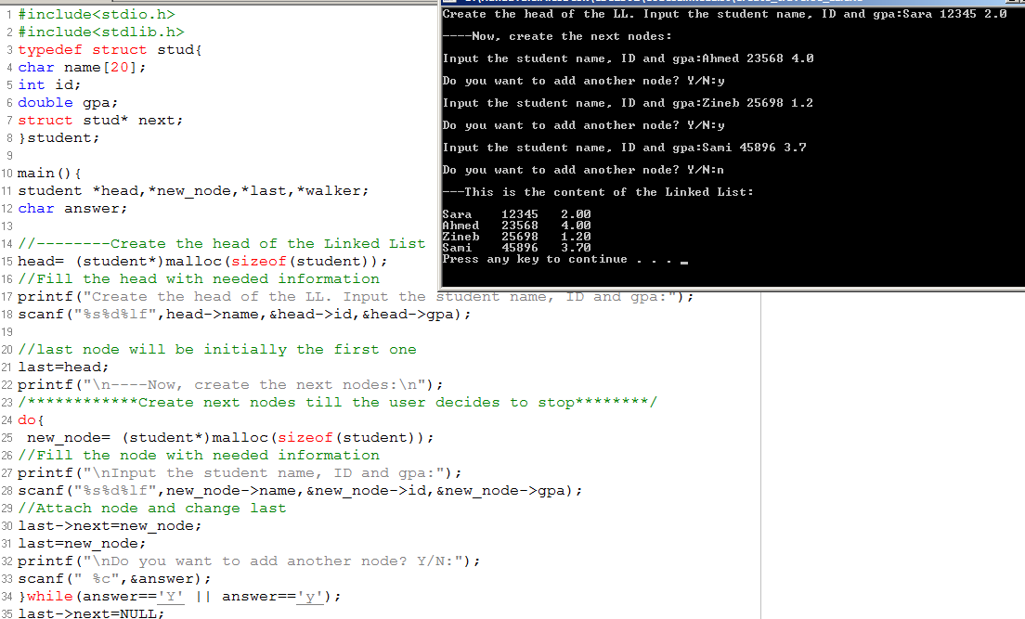

Slide 20
Traversing the list
The program in the previous slide seems to be valid, but how can we assess it?
One simple way to do so is to traverse the list and print the data in each node.
Algorithm:
1. Set pointer to the first node in the list
2. While (you did not reach the end of the list)
2.1 process node (current node)
2.2 move to next

Slide 21
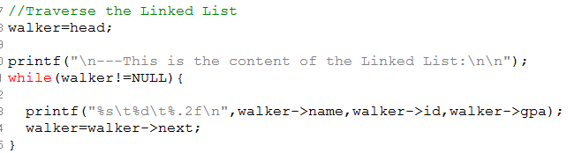
Traversing the List: Illustration

Slide 22
Inserting a node
Algorithm:
1. Allocate memory for the new node
2. Determine the insertion point:
That is the position within the list where the new data are to be placed.
To identify the insertion position, you need to know only the new node’s logical predecessor
3. Point the new node to its successor
4. Point the predecessor to the new node
Important: Adding to the beginning of the list is a special case not conforming to the algorithm above since this later tracks always the predecessor!

Slide 23
Insert a Node Illustration
We will represent a student with the followings:
First name
Last name
Gpa
We will create a link list of students using their GPA (ascending order)
Initial list is not an ordered one: we will use appropriate input

Slide 24
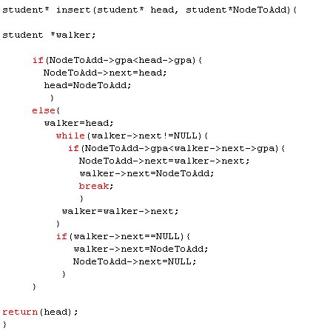
Illustration

Slide 25
Delete a Node from the List
To delete a node, you must first locate the node to delete identified by current and its predecessor
Algorithm:
Locate the node to delete and its predecessor
Point the predecessor to successor(current-> next)
Release the node used memory by using free.
Tip:
Deleting the head is a special case to be treated separately.

Slide 26
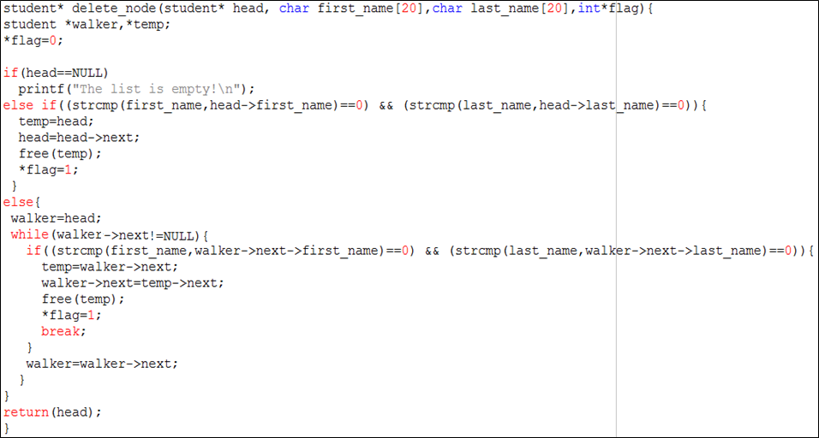
Illustration

Slide 27
Put everything together using examples!

Slide 28
Managing a Linked List using set of functions
An auction is a very good example to use to manage a linked list.
We should be able to create a linked list by adding, removing and updating participants and finally state the winner.

Slide 29
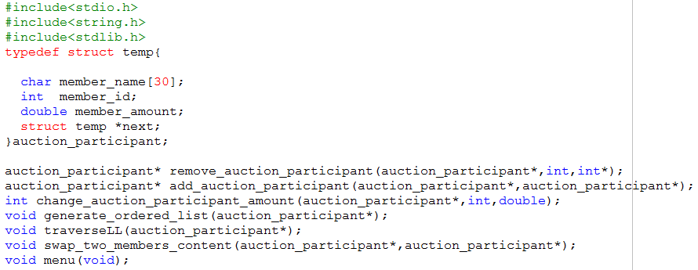
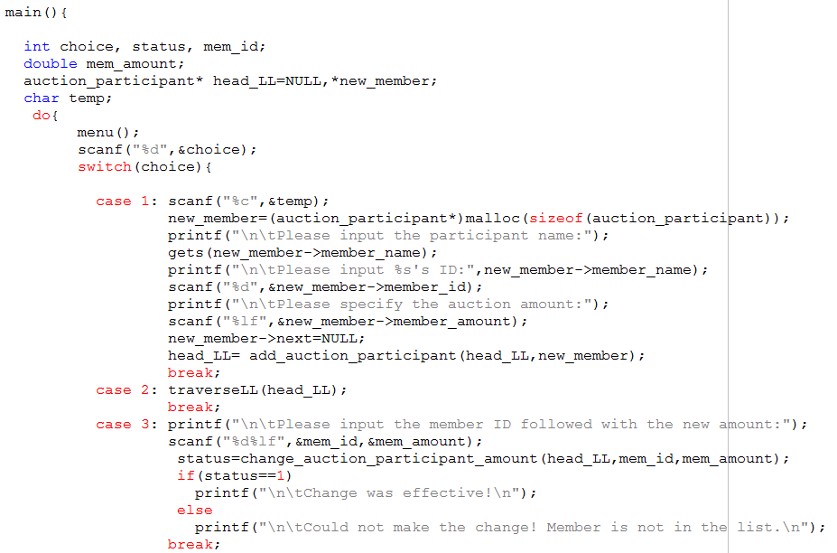

Slide 30
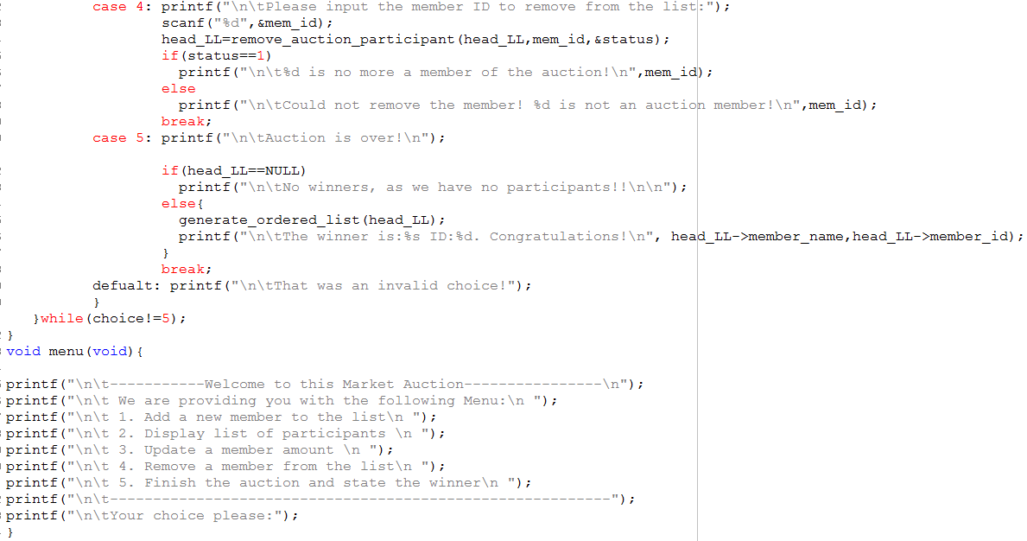

Slide 31
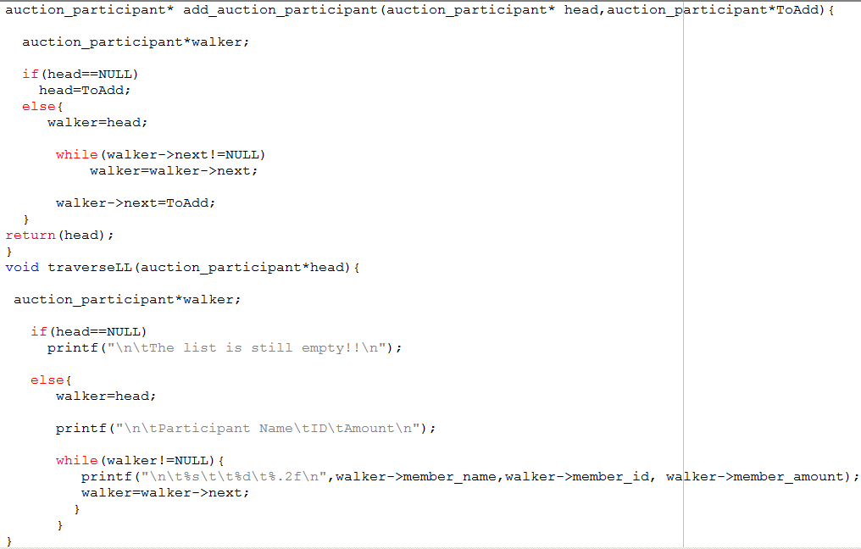

Slide 32
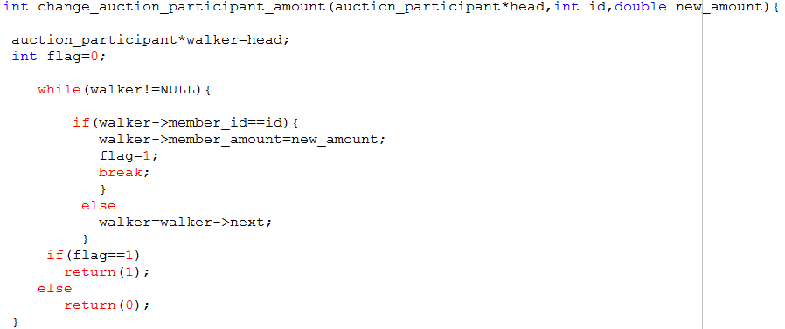
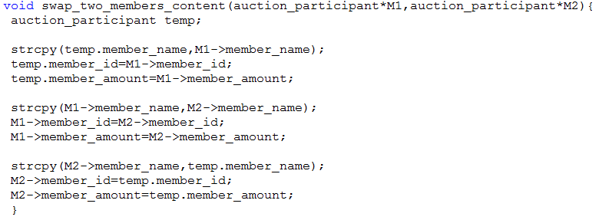

Slide 33
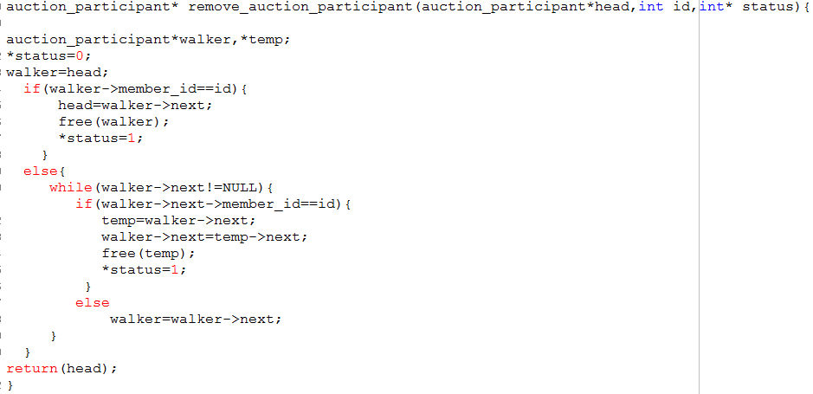

Slide 34
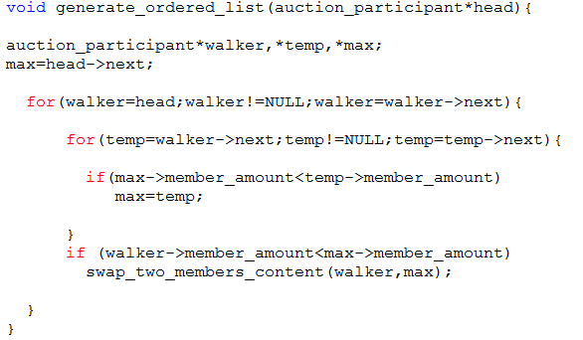

Slide 35
Exercise
During the graduation ceremony, students belonging to a school are called on stage using their GPAs. The first student called is the one that has the highest GPA (Valedictorian)
We want to write a C program where we create a student list based on GPAs (descending order).
For a specific student X, we would like to know the students GPAs classified before and after X GPA.

Slide 36
Solution

Slide 37
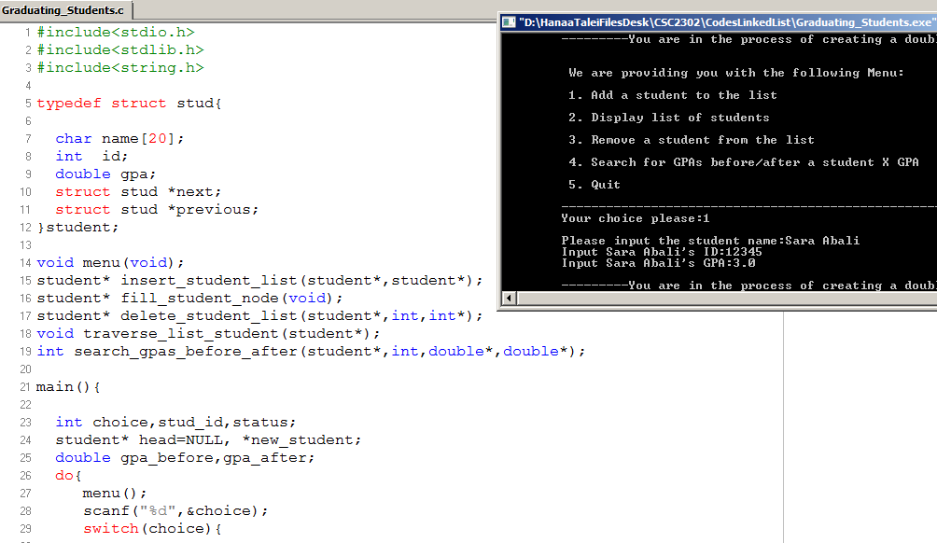
Solution

Slide 38
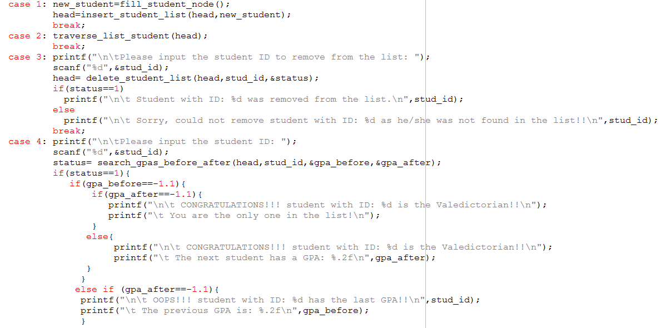

Slide 39
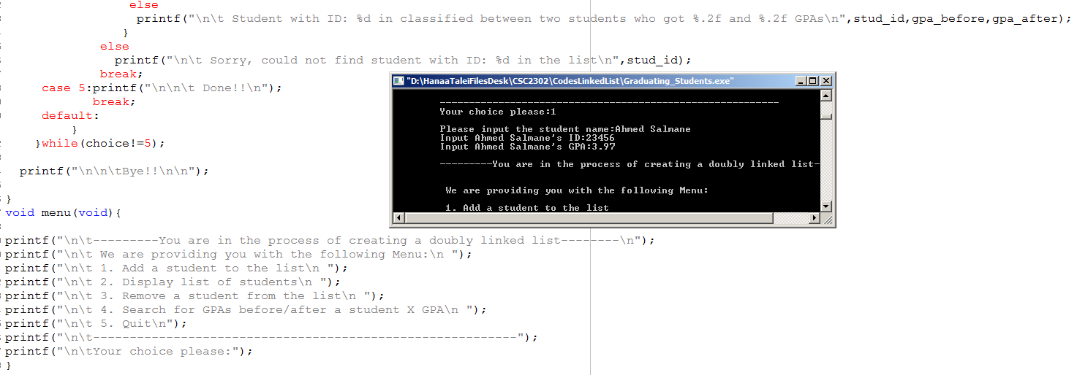

Slide 40
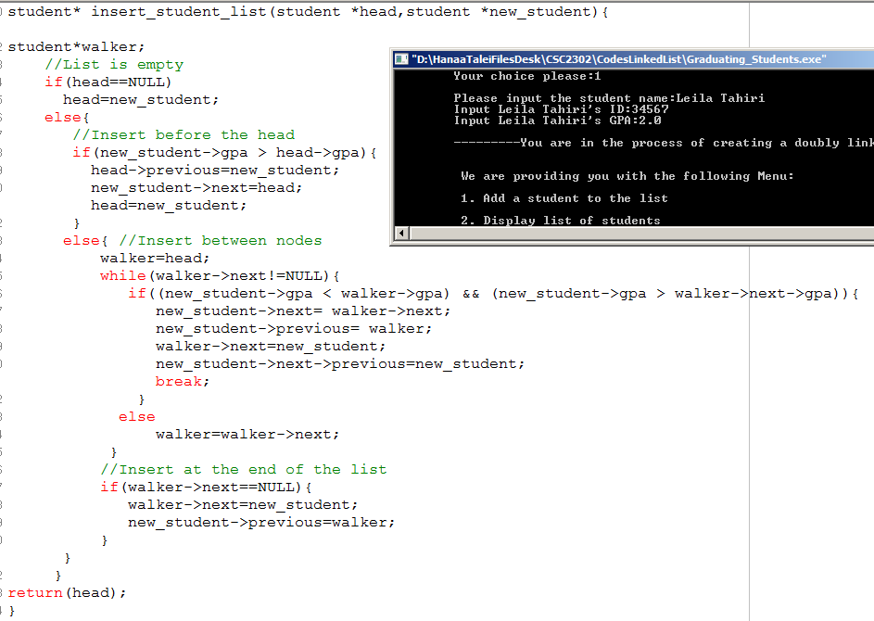

Slide 41
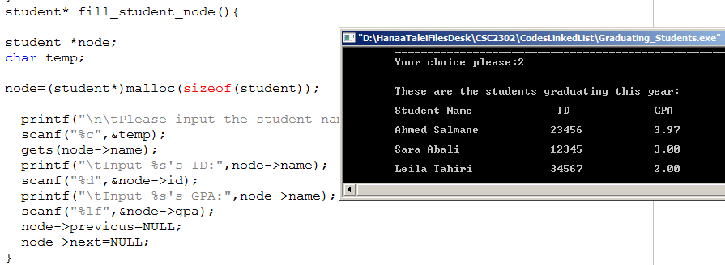
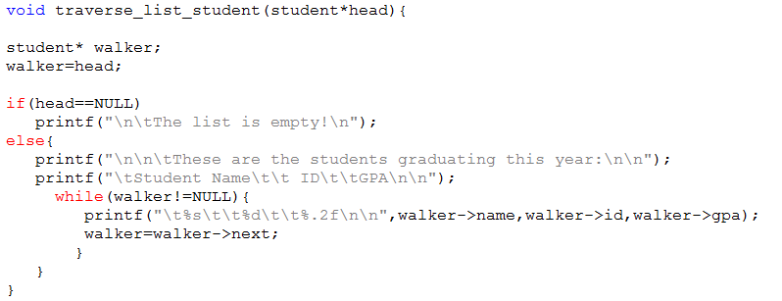

Slide 42
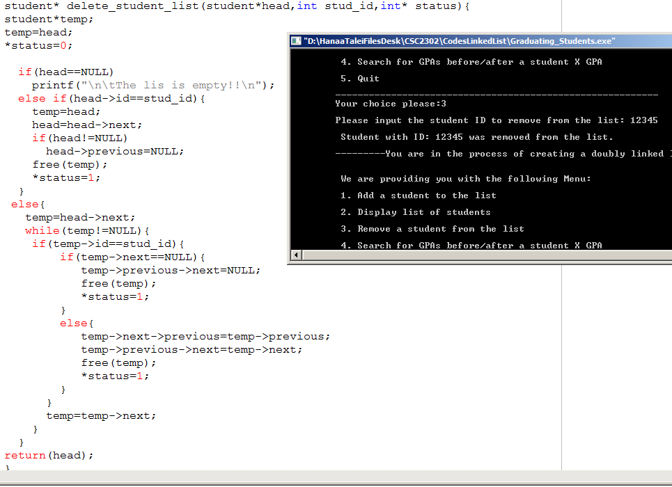

Slide 43
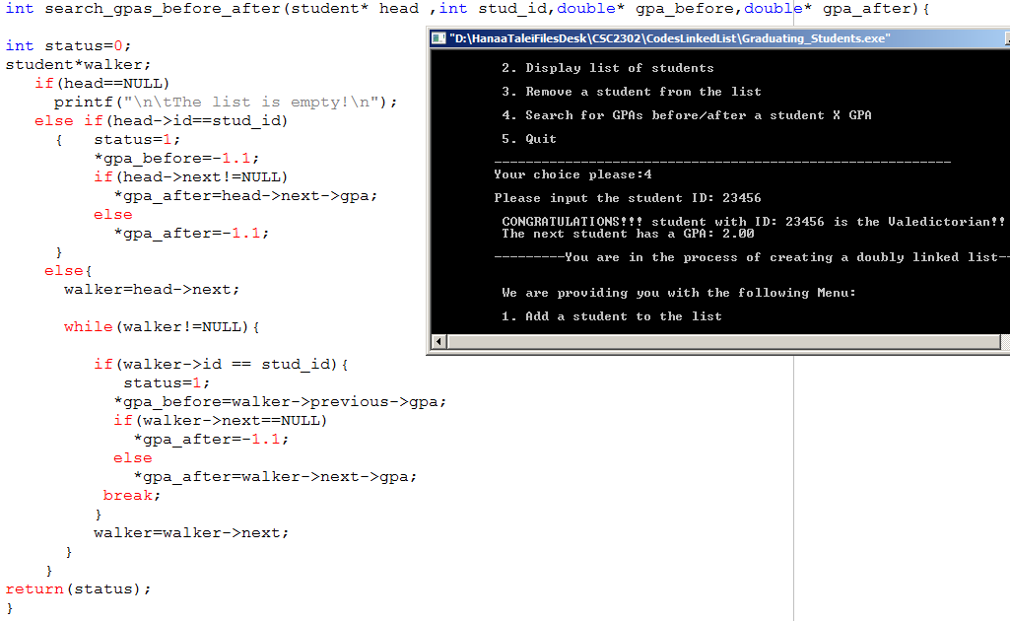

Slide 44
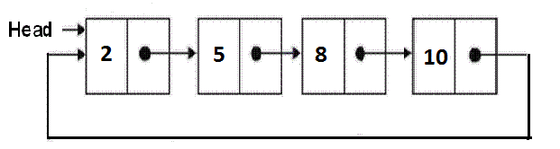
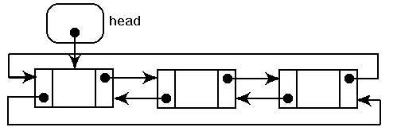
Other variations of Linked lists

Slide 45
Conclusion
Linked List vs Arrays
Advantages
Disadvantages

Slide 46
Arrays
Advantages
Easier to use and access
Faster access to the elements
Disadvantages
Fixed size - the size of the array is static
Improper utilization of memory
Complex position-based insertion

Slide 47
Linked List
Advantages
Dynamic allocation - the size is not required to be known in advance
No single allocation of memory needed
Linked list can grow or shrink according to the user requirement.
Memory gets properly utilized as the allocation and de-allocation of the memory is done whenever it is required.
Flexibility - insert at (or delete from) any position
Disadvantages
Complex to use and access - relatively complex as compared to arrays
Extra memory used for addresses
Linked list have slower access time than arrays as it has to traverse from one node to another.

